Slide 1
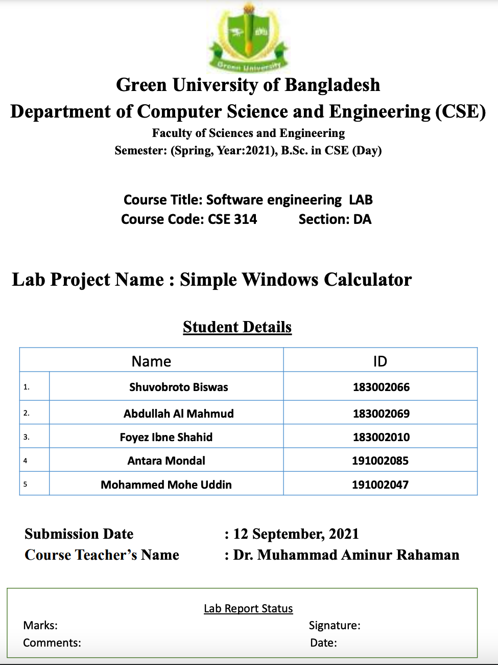
2022
Algorithom LAB
CSE 206
Emotion Recognitions System
2. | Shishir Chandra Dash | 203002071
14 May 2022
Md. Gulzar Hussain

Slide 2
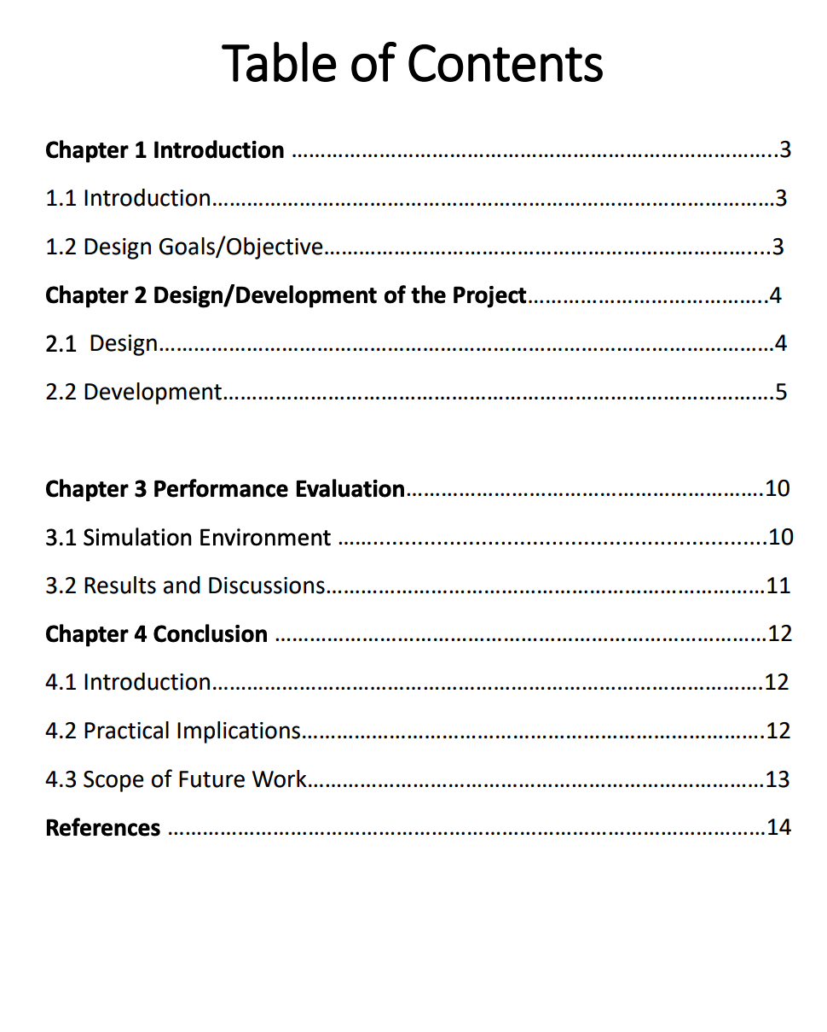

Slide 3
Chapter 1 Introduction
1.1 Introduction: Extracting and validating emotional cues through analysis of users' facial expressions is of high importance for improving the level of interaction in man machine communication systems. Extraction of appropriate facial features and consequent recognition of the user's emotional state that can be robust to facial expression variations among different users is the topic of this paper. Facial animation parameters (FAPs) defined according to the ISO MPEG-4 standard are extracted by a robust facial analysis system, accompanied by appropriate confidence measures of the estimation accuracy. A novel neurofuzzy system is then created, based on rules that have been defined through analysis of FAP variations both at the discrete emotional space, as well as in the 2D continuous activation–evaluation one. The neurofuzzy system allows for further learning and adaptation to specific users' facial expression characteristics, measured though FAP estimation in real life application of the system, using analysis by clustering of the obtained FAP values.
1.2 Design Goals: I made a system that can detect emotion via live video . And as a programming language we have used python. We will analyse the rest in place of implementation. ok now here we go .

Slide 4
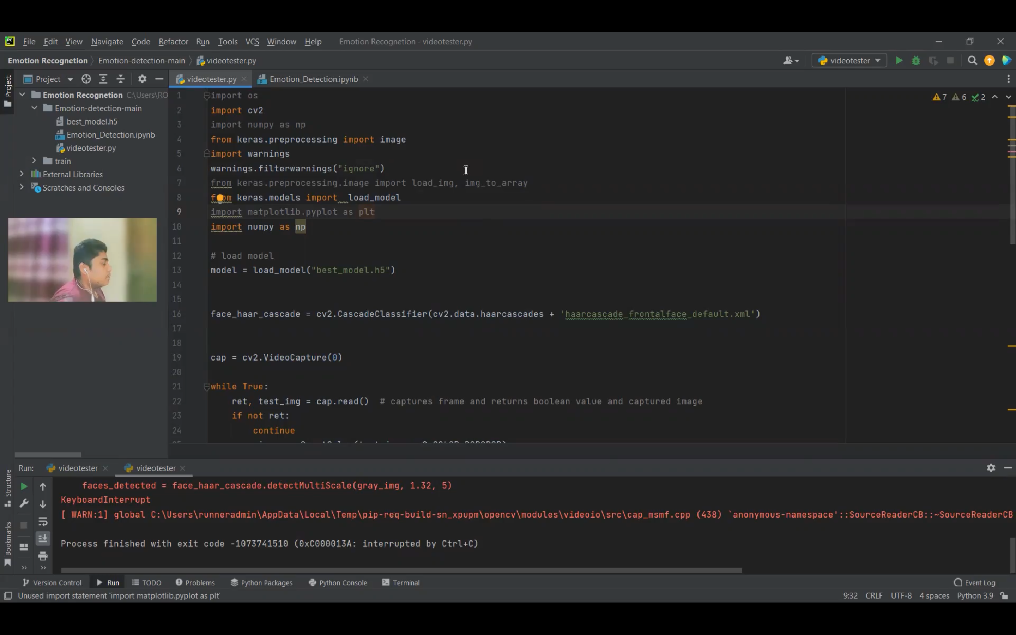
Chapter 2
2.0 Implementation of the Project
2.1 Design :

Slide 5
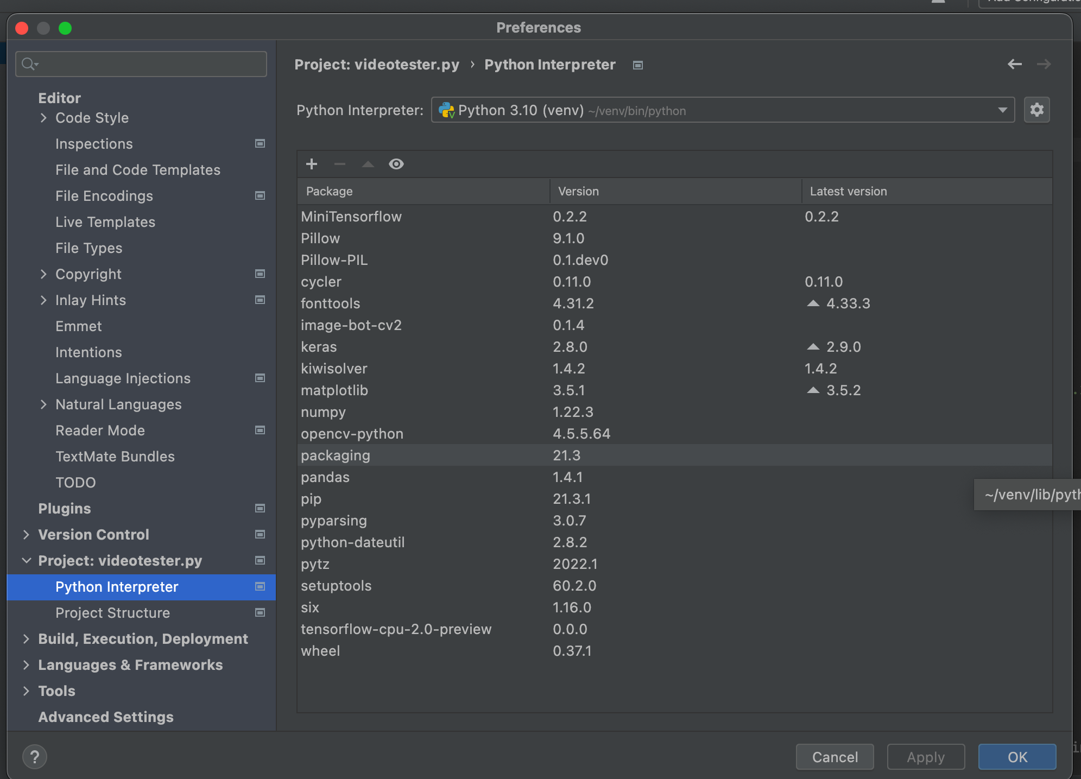
2.2 Development: Add dependency on my machine for start neural engine.

Slide 6
Write code :
import os import cv2 from keras.preprocessing import image import warnings warnings.filterwarnings("ignore") from keras.preprocessing.image import load_img, img_to_array from keras.models import load_model import matplotlib.pyplot as plt import numpy as np # load model model = load_model("best_model.h5") face_haar_cascade = cv2.CascadeClassifier(cv2.data.haarcascades + 'haarcascade_frontalface_default.xml') cap = cv2.VideoCapture(0) while True: ret, test_img = cap.read() # captures frame and returns boolean value and captured image if not ret: continue gray_img = cv2.cvtColor(test_img, cv2.COLOR_BGR2RGB) faces_detected = face_haar_cascade.detectMultiScale(gray_img, 1.32, 5) for (x, y, w, h) in faces_detected: cv2.rectangle(test_img, (x, y), (x + w, y + h), (255, 0, 0), thickness=7) roi_gray = gray_img[y:y + w, x:x + h] # cropping region of interest i.e. face area from image roi_gray = cv2.resize(roi_gray, (224, 224)) img_pixels = image.img_to_array(roi_gray) img_pixels = np.expand_dims(img_pixels, axis=0) img_pixels /= 255 predictions = model.predict(img_pixels) max_index = np.argmax(predictions[0]) emotions = ('angry', 'disgust', 'fear', 'happy', 'sad', 'surprise', 'neutral') predicted_emotion = emotions[max_index] cv2.putText(test_img, predicted_emotion, (int(x), int(y)), cv2.FONT_HERSHEY_SIMPLEX, 1, (0, 0, 255), 2) resized_img = cv2.resize(test_img, (1000, 700)) cv2.imshow('Facial emotion analysis ', resized_img) if cv2.waitKey(10) == ord('q'): break cap.release() cv2.destroyAllWindows

Slide 7
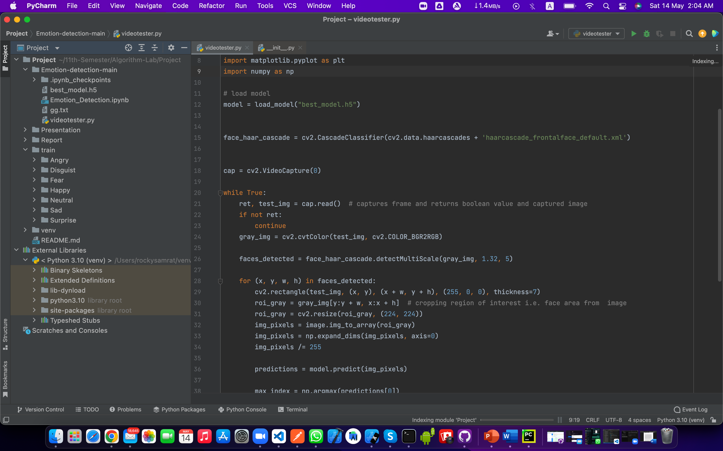
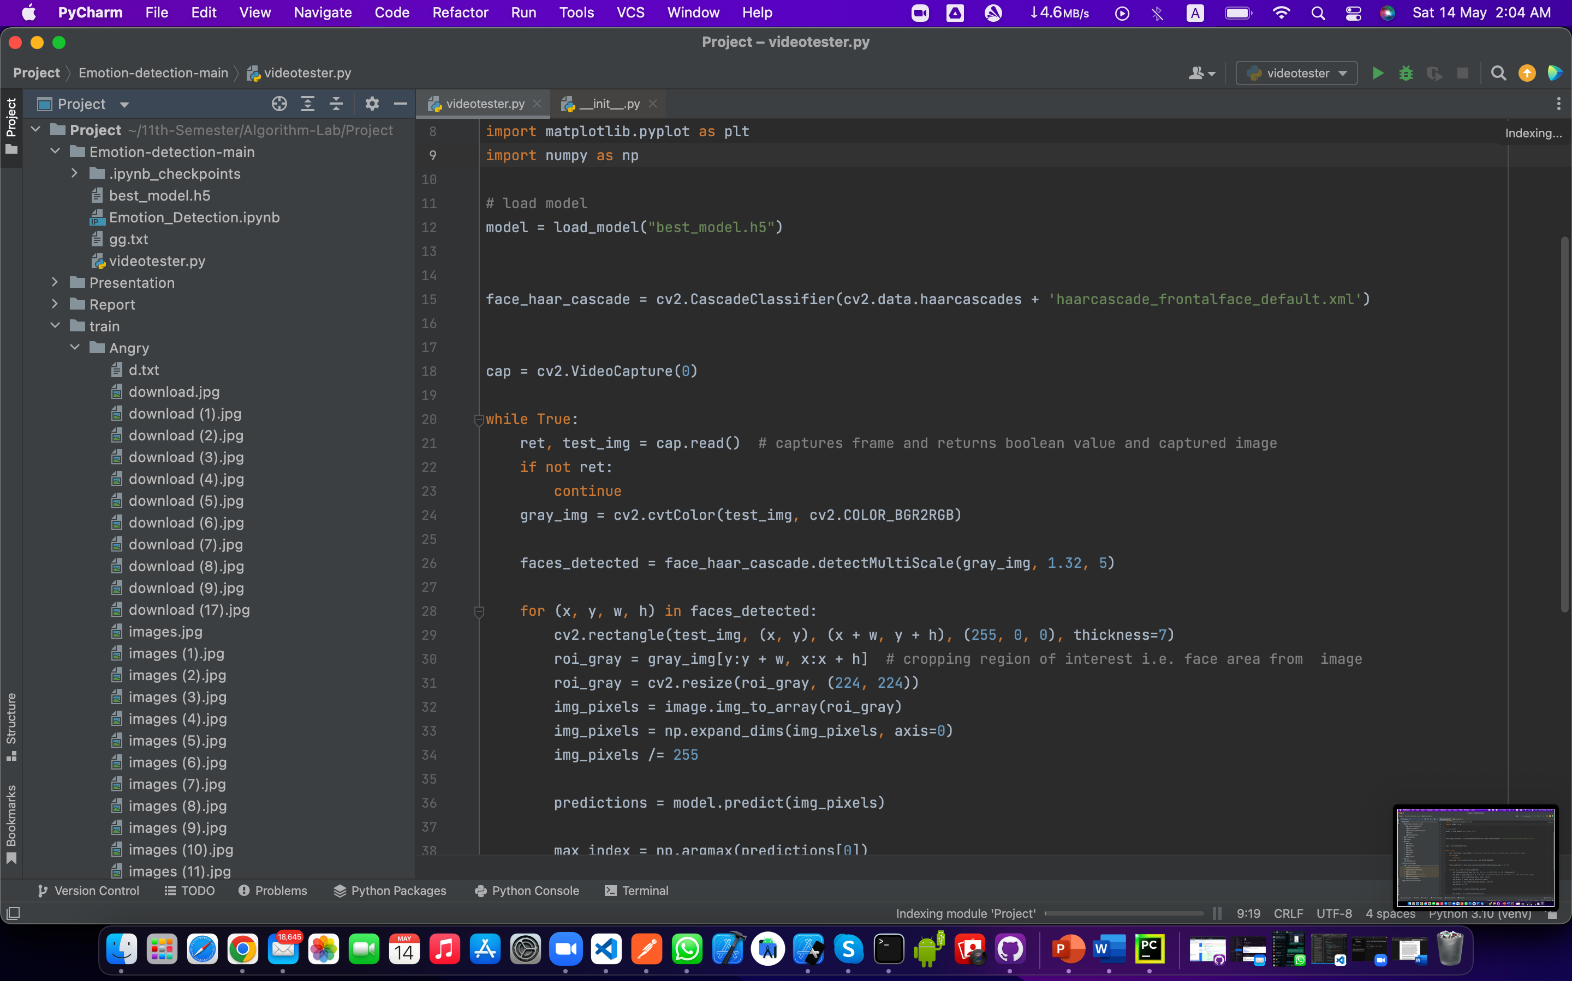
Setup dataset and start train:

Slide 8
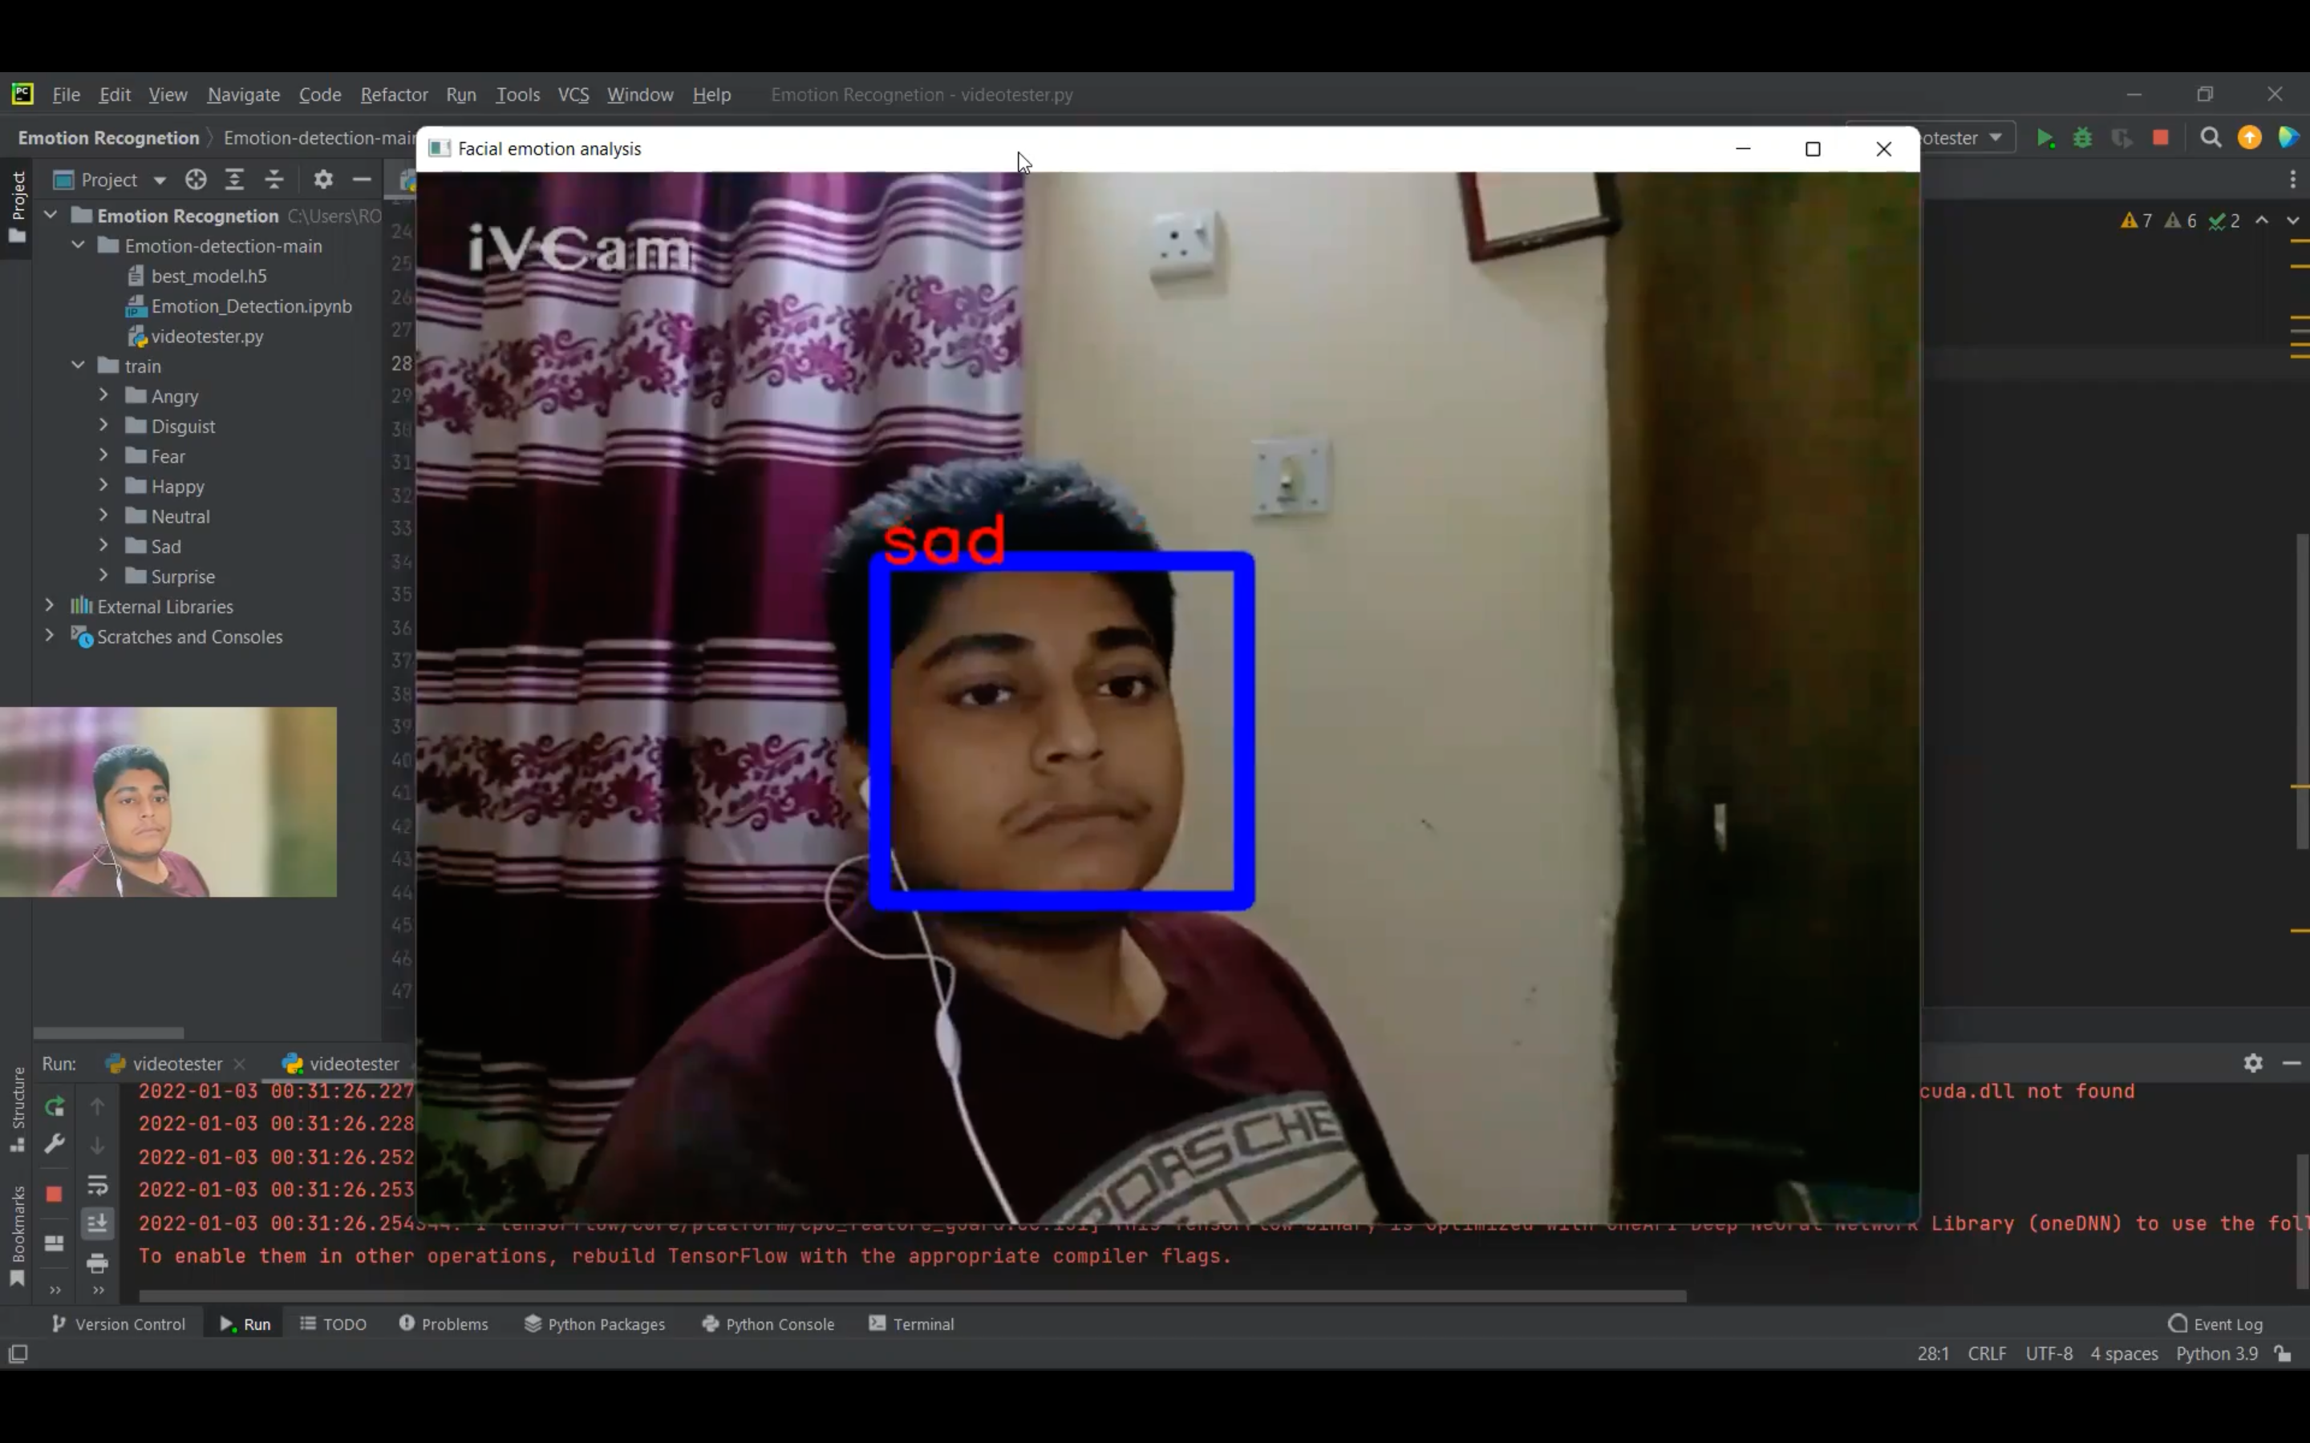
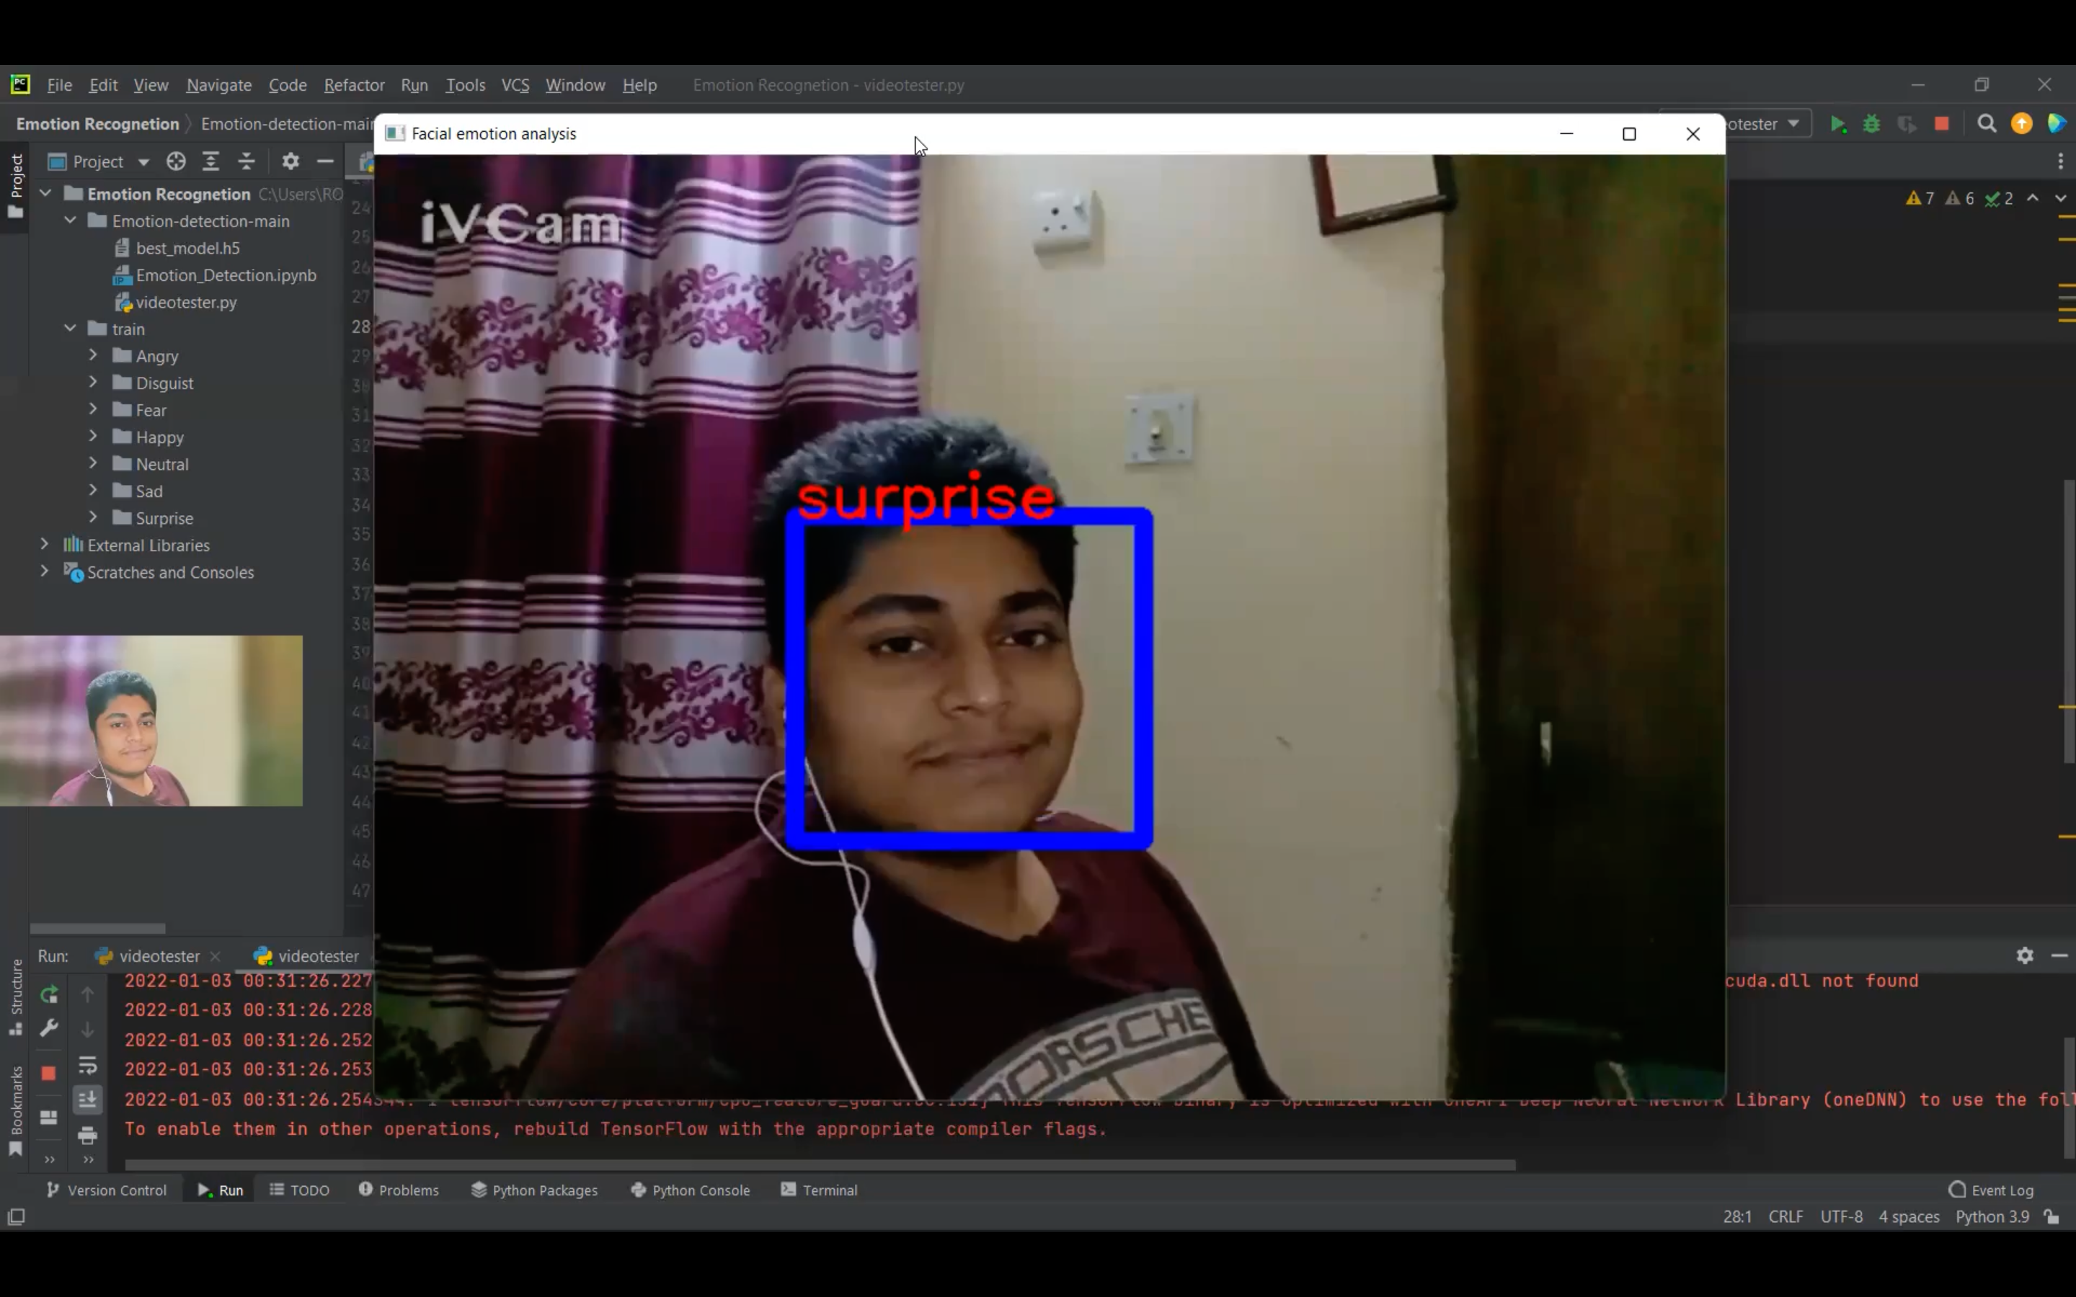
Emotion Check

Slide 9
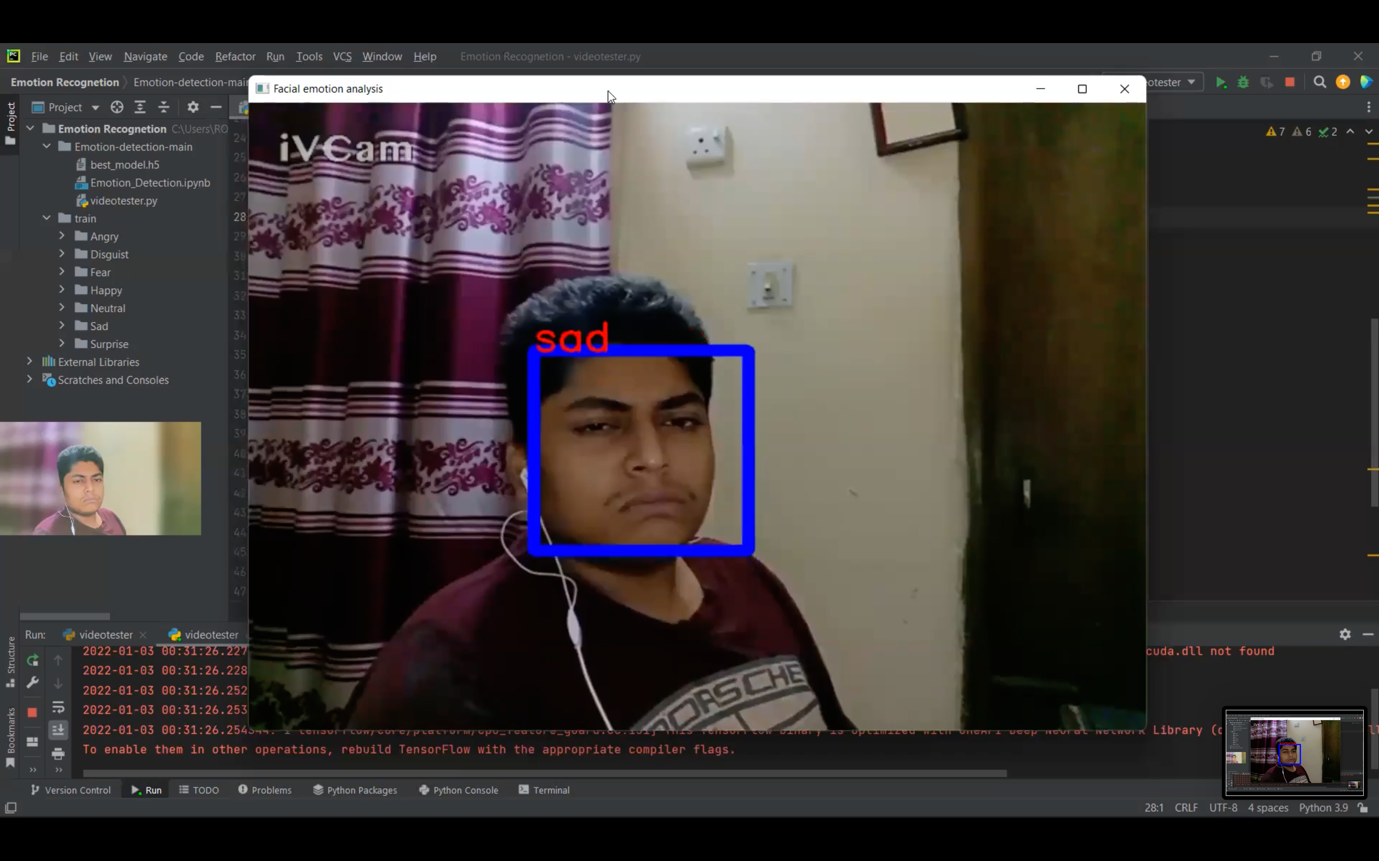

System ok

Slide 10
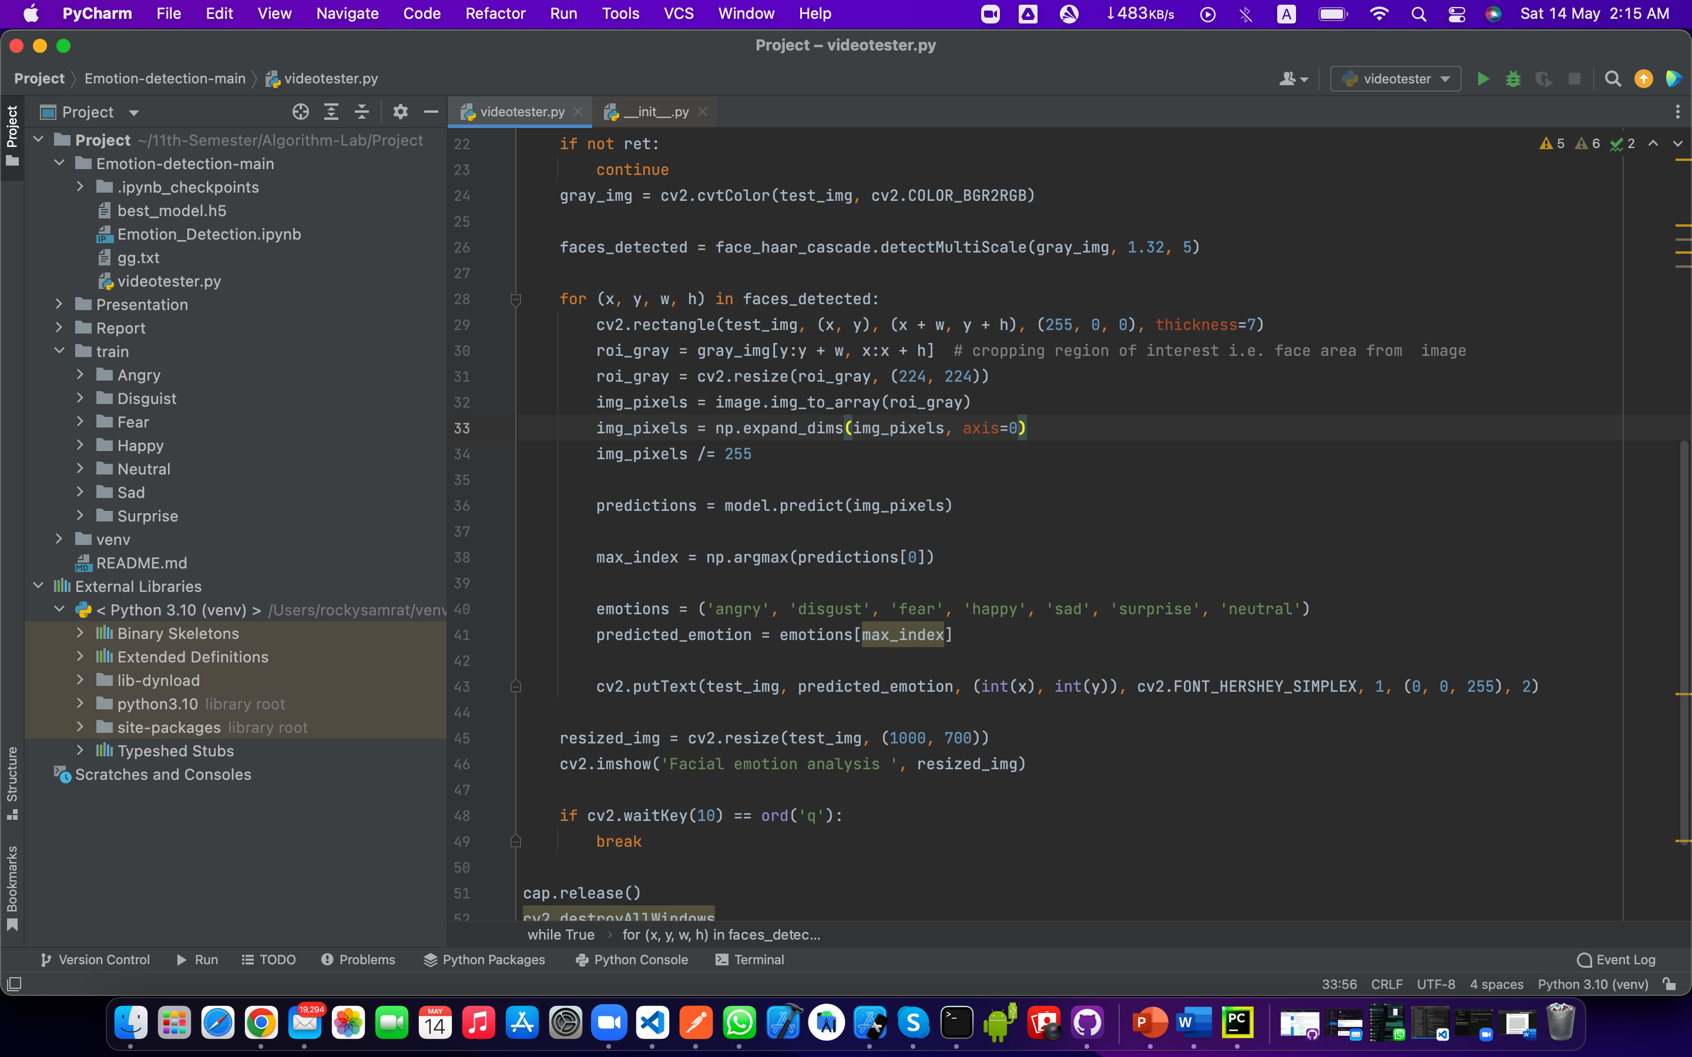
Chapter 3 Performance Evaluation
3.1 Simulation Environment
To simulation click on Start then will be showed like that snapshot and check Diagnostics Realtime status

Slide 11
3.2 Results and Discussions:

Slide 13
Chapter 4 Conclusion
4.1 Introduction: This project has really been faithful and informative. It has made us learn and understand the many trivial concepts of python Language. As we have used pycharm as a GUI it provides various controls, such as image processing , k-means, neural network to build a user friendly system.
4.2 Practical Implications: In this project, we outline the approach we have developed to construct an emotion-recognising system. It is based on guidance from psychological studies of emotion, as well as from the nature of emotion in its interaction with attention. A neural network architecture is constructed to be able to handle the fusion of different modalities (facial features, prosody and lexical content in speech). Results from the network are given and their implications discussed, as are implications for future direction for the research.

Slide 14
4.2 Scope of Future Work
The main issue in the project was time. To improve performance you can very the dropout, number of dense layers and activation functions. We also used transfer learning with a CNN called VGG which is a pre-trained convolutional neural network for image classification. Our accuracy using pixels was about 50%, this increased when instead of using pixel values, we used the distances between the facial landmarks. However we wanted models that would be even more accurate, so we decided to use CNNs.
We will fix this in future .

Slide 15
References
[1] Full concept in Github
https://github.com/ShuvobrotoBiswas/Emotion-Recognetion
14/05/2022 , 02:30AM , Shuvobroto Biswas
[2] Concept , Edureka
https://www.edureka.co/blog/tensorflow-object-detection-tutorial/
Kislay Keshari, Last updated on Dec 19,2021
[3] Video Concept , Youtube
https://www.youtube.com/watch?v=fkgpvkqcoJc
DeepLearning_by_PhDScholar, Sep 26, 2020
[4] Dataset , Edureka
https://www.dropbox.com/s/w3zlhing4dkgeyb/train.zip?dl=0
Academy NIT Warangal, Sep 17, 2021

